Slide 1

DYAL SINGH COLLEGE
NAME : ANKIT
PROGRAMME : B.Sc HONS. COMPUTER SCIENCE
GE : PHYSICAL EDUCATION
ROLL NO : 20/49005
TOPIC : EVALUATION OF FITNESS.

Slide 2
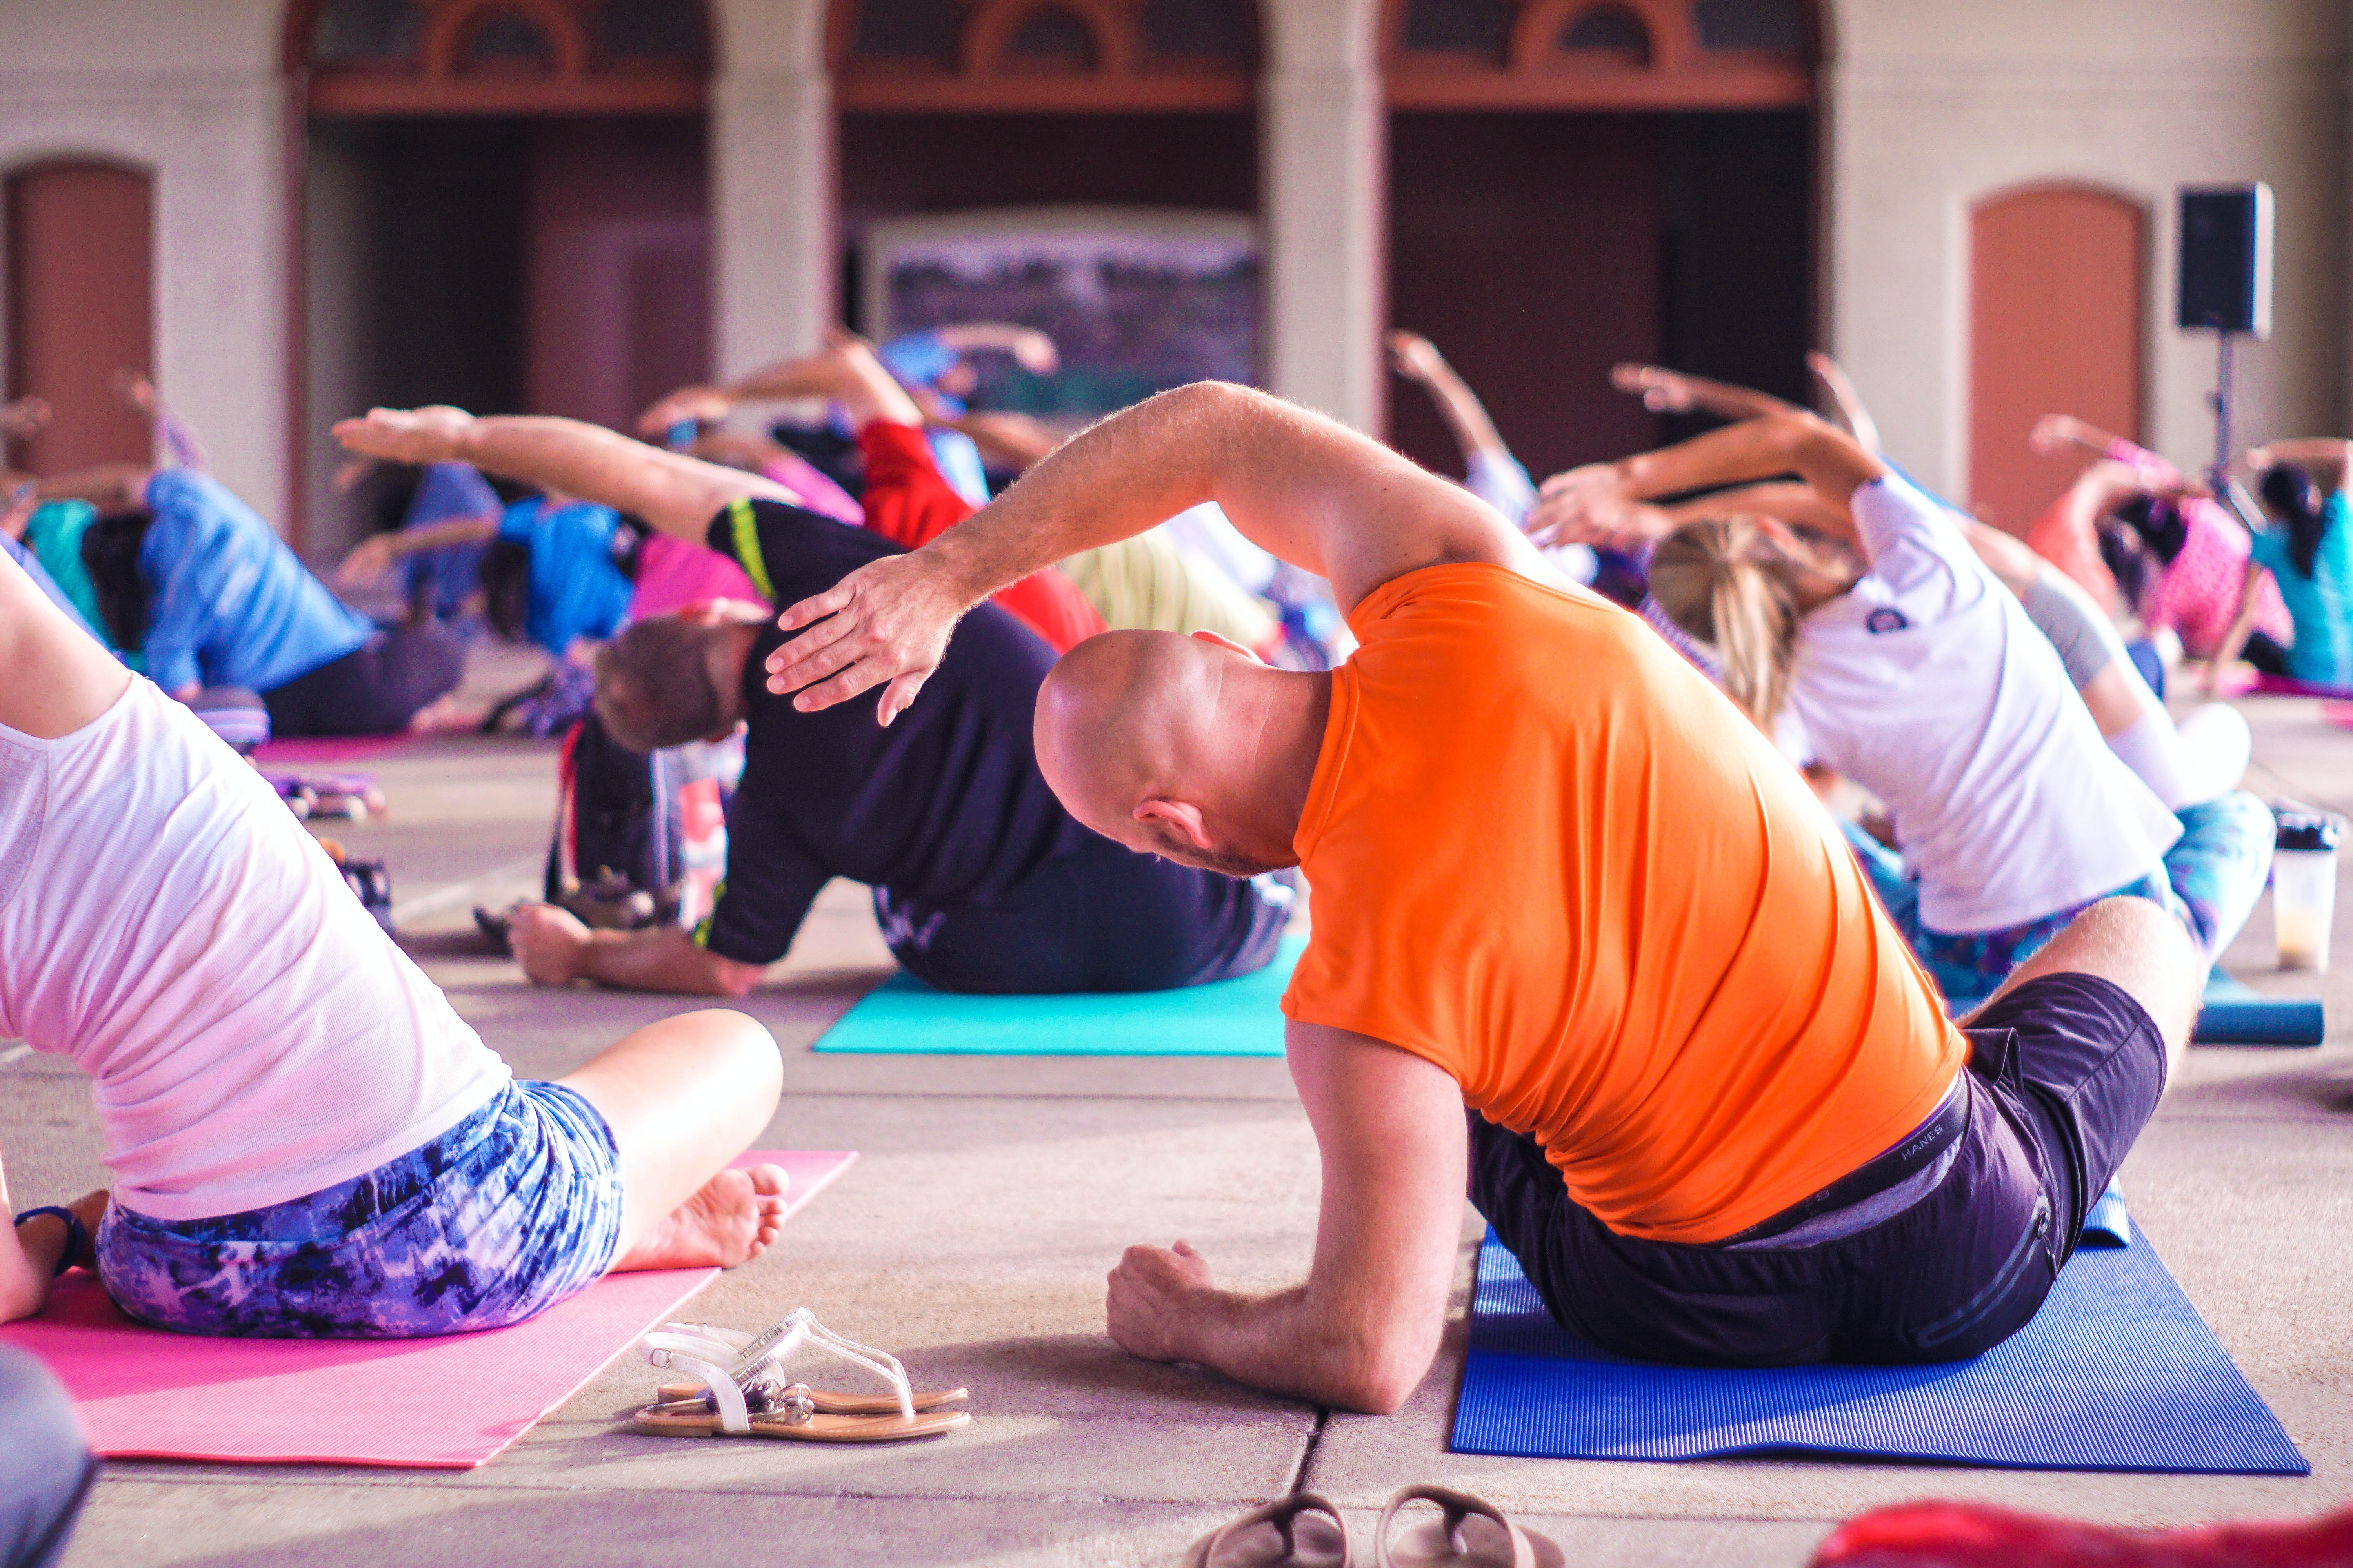
GE :EVALUATION OF FITNESS Paper code : 12555423

Slide 3
CERTIFICATE
THIS IS TO CERTIFY THAT THE PROJECT ENTITLED, “EVALUATION OF FITNESS" SUBMITTED BY “AYUSH KUMAR" IN PARTIAL FULFILLMENT OF THE REQUIREMENTS FOR THE AWARD OF “GENERIC ELECTIVE" IN “ PHYSICAL EDUCATION " IS AN AUTHENTIC WORK CARRIED OUT BY HIM UNDER MY SUPERVISION AND GUIDANCE. CERTIFIED BY :
MR.SANDEEP SIR

Slide 4
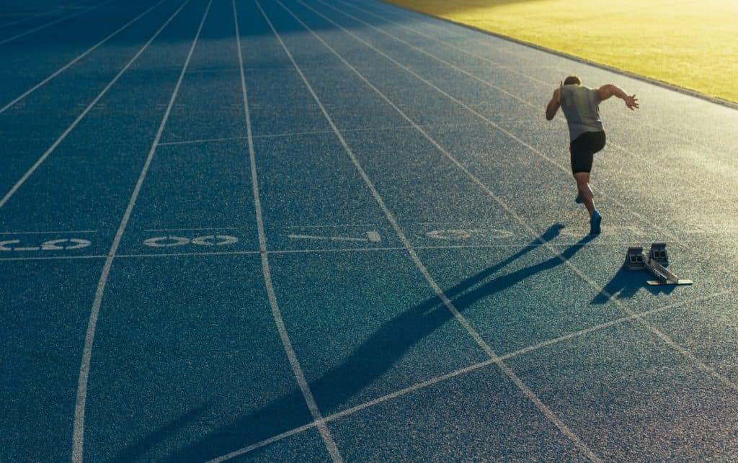
COOPER’S TEST

Slide 5
12 MINUTE RUN TEST
Developed in the 1960 s by Dr Cooper, the 12-minute run test measures how far a person can cover (run, walk, jog) in 12 minutes. Simple. Ideally you want to take this test on a standard running track, or a location where you can measure distance run without having to stop. If you're struggling to find anywhere the treadmill could be an option, however, remember that this is an artificial environment. You will need to raise the belt to a 1 degree incline to simulate outdoor running.
You will need :
- A stopwatch and Something to record the distance covered, such as cones placed around the running track at standardized distances.
what to do ? - Warm-up before you take the test (5-10 minutes of light jogging and stretching).
- Start the timer and off you go!
- Run, jog or walk for the whole 12 minutes.
- Record the distance covered.

Slide 6
Distance: Record the total number of miles or kilometres you travelled in 12 minutes.
Equipment: You'll need a timer to know when 12 minutes are up. Note that some running watches and fitness monitors have a 12 -minute fitness test mode.
Location: This test is designed to be conducted on a track with clearly marked distance. You can perform the test on a treadmill, but be sure to raise the incline to one degree to simulate outdoor running.
Safety: This is a strenuous fitness test and it's recommended that you have your physician's clearance before performing this test on your own.
Speed: When you are warmed up, get going. Run or walk as far as you can in 12 minutes.
Warm-up: Perform a short warm-up of 10 to 15 minutes of low to moderately strenuous activity before performing any fitness testing.
Calculate the 12-Minute Run Test Results
To calculate your estimated VO2 Max results (in ml/kg/min) use either of these formulas:
- Kilometres: VO2max = (22.351 * kilometres ) -11.288
- Miles: VO2max = (35.97 * miles)-11.29

Slide 7
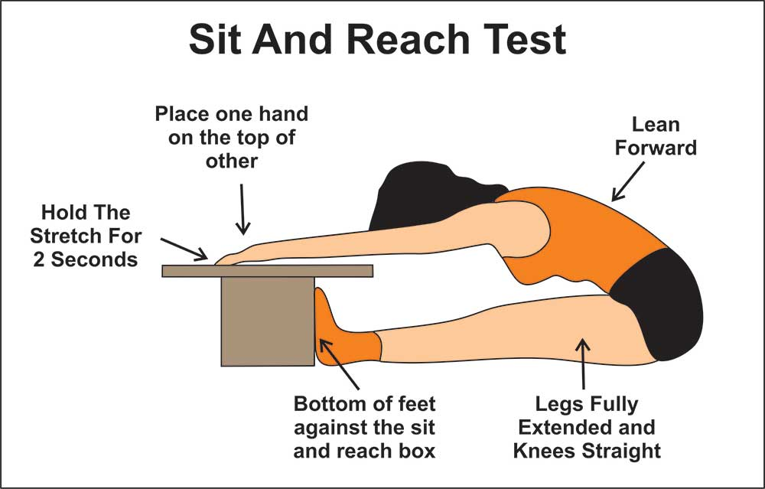
SIT AND REACH TEST

Slide 8
SIT AND REACH flexibility at home
Push Up | Sit Up | Squat | Step | Vertical Jump | Sit & Reach
This simple test is designed to measure the flexibility of your hamstrings and lower back. The sit and reach test has long been used as a test to represent a person's flexibility, though actual flexibility may differ around the body.
How to Perform the Sit and Reach Test
First, you'll need a special sit-and-reach testing box. You can also make your own testing box by finding a solid box about 30 cm tall. Fix a meter stick on top of the box so that 26 cm of the ruler extends over the front edge of the box toward the test subject. The 26 cm mark should be at the edge of the box.
Get in position: Remove your shoes and sit on the floor with your legs stretched out in front of you with knees straight and feet flat against the front end of the test box.
Begin the movement: In a slow, steady movement, lean forward at the hips, keep your knees straight, and slide your hand up the ruler as far as you can go.
Stretch and repeat: Extend as far as you can, record the result in \(\mathrm{cm}\), rest, and repeat three times.
Calculate your results: Average your results for your final score.

Slide 9
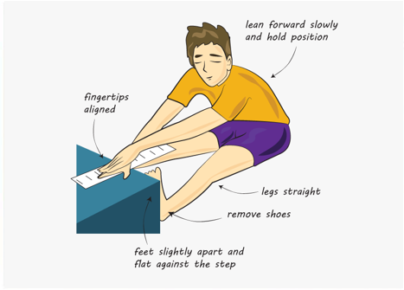
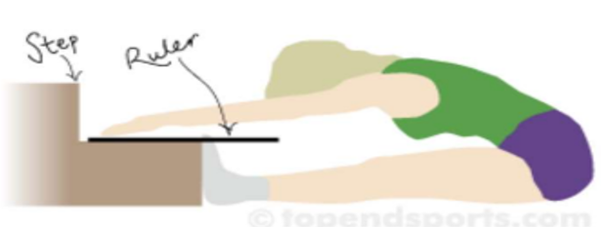
Measurement
Mark or take note of your best score, take a measure in cm or inches beyond the base of your foot, or you did not reach your toes, measure how far before the feet you were (a negative measurement score).
How did you go?
Compare your results to the table below. Remember, these scores are based on doing the tests as described, and may not be accurate if the test is modified at all. Don't worry too much about how you rate - just try and improve your own score.

Slide 10
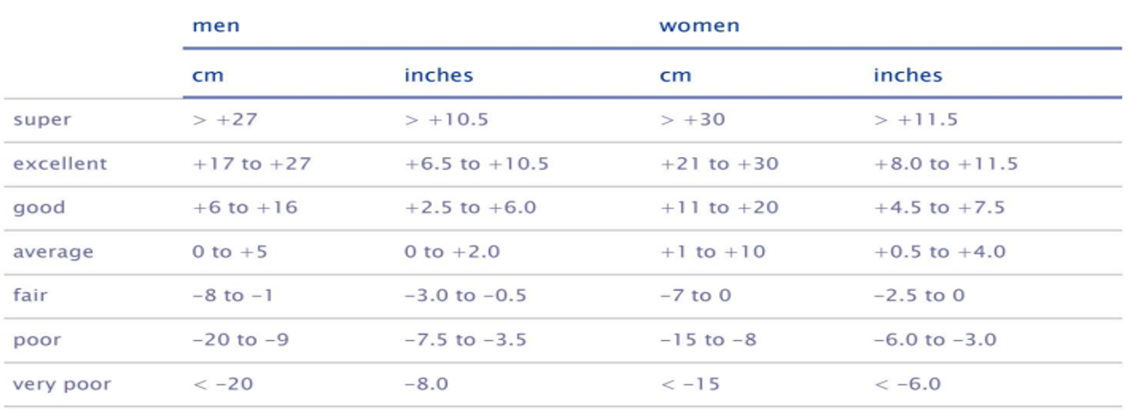

Slide 11
MODIFIED SIT UPS
For the best results, sit-ups should be performed three to five times a week. When practicing sit-ups place a towel or other soft material under your tailbone or practice on a mat. The best method of practicing sit-ups is to do them the same way they are tested.
The following are variations of the exercise you can practice:
THE CURL-UP
POSITION. Lie on your back with your feet as close to your buttocks as possible. Cross your arms over your chest with your hands on the opposite shoulders. DO NOT HOLD YOUR FEET DOWN, although they must remain in contact with the ground at all times.
ACTION. Raise your head and shoulders off the ground, hold for five seconds, and return to the starting position. Repeat 10 to 20 times. Gradually increase the number of repetitions. Exhale as you sit up.
LEGS ON A CHAIR
POSITION. Lie on back with feet and lower legs on a chair. Interlock your fingers behind your head. DO NOT HOLD YOUR FEET, although they must remain in contact with the chair at all times.
ACTION. Raise your head and shoulders off the ground, hold for five seconds, and return to the starting position. Repeat 10 to 20 times. Gradually increase the number of repetitions during sessions. Exhale when you curl up.

Slide 12
ALTERNATING ELBOW TO KNEE
POSITION. Lie on your back and interlock your fingers behind your head. Your legs should be off the ground, knees should be bent and lower legs parallel to the ground.
ACTION. While the left knee is pulled towards the chest and touched with the right elbow, straighten the right leg, but keep it off the ground. Reverse the action bringing the right knee up to the left elbow and straightening the left leg. Repeat the action continuously for 20 counts with each leg.
EXERCISE WITH A SLANT BOARD
POSITION. Lie on a slant board with your feet higher than your head. Interlock your fingers behind your head. Bend your knees and keep your feet flat on the slant board.
ACTION. Sit up and touch your elbows to your knees. Then return to the starting position. Repeat up to 30 times. When you can perform 30 repetitions, raise the slant board.
SIT-UPS DONE WITH WEIGHTS
POSITION. Perform any other previously mentioned exercises or sit-ups with a weight held on your chest.
ACTION. The same actions described above for each type of sit-up.

Slide 13
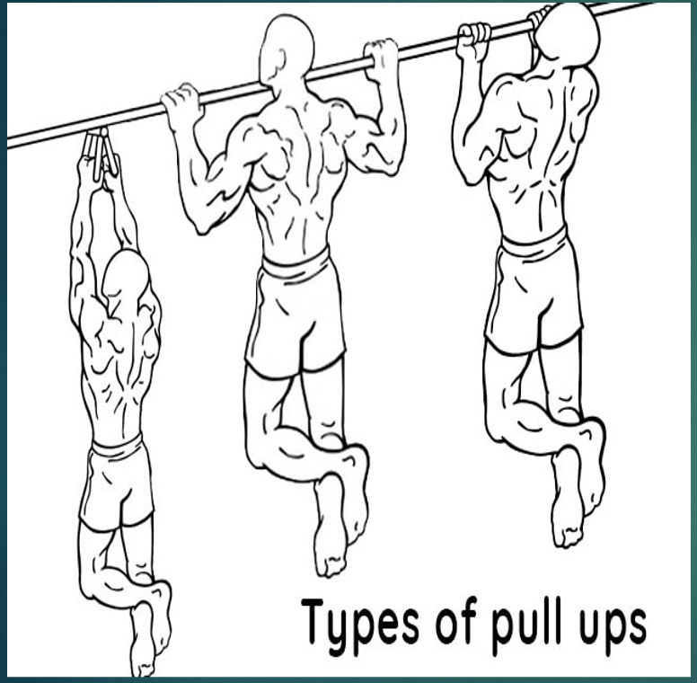
pull ups/flexed arm hang

Slide 14
Name of the Test:
A) Pull-ups for Boys
B) Flexed Arm Hang for girls
Aim : The purpose of pull-ups and flexed arm hang test is to measure the muscular strength of upper body.
Equipment Required: For this practical a horizontal bar, whistle, stop watch and stool/chair are required.
A) Testing Procedure of Pull-ups: The participant will be asked to hang from the horizontal bar through hands with forward grip and to chin up by pulling body up until his chin is above the bar. After that he has to lower the body until his arms are straight (shown in the figure). In whole process kicking or jerky motion are not allowed.
Scoring Procedure: The number of complete pull-ups plus constitute the scoring.

Slide 15
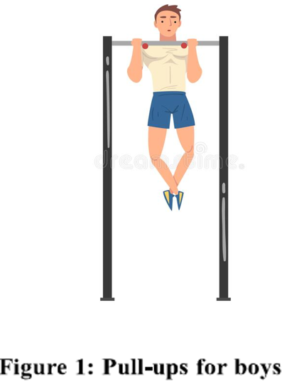
B) Testing Procedure of Flexed Arm Hang : The participant will be asked to grip the horizontal bar using overhand grip. The body will be raised off the floor to a position where the chin is above the bar without touching the bar with the help of stool or chair. After reaching said position the stool/chair will be removed. In final position both the elbows are flexed and the chest comes
Scoring Procedure: The duration is seconds for which the participant holds the flexed arm hang position correctly, is the score of the test.

Slide 16
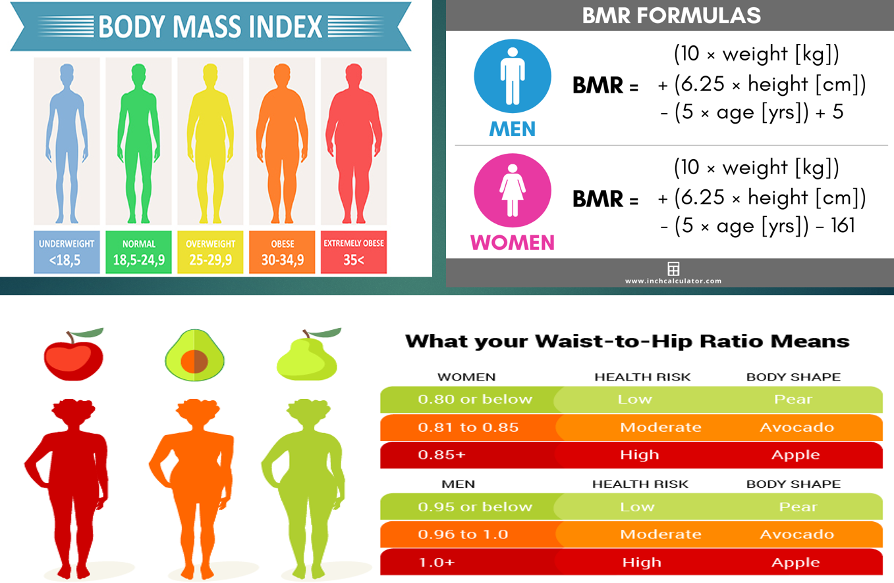
BMI, BMR, WHR

Slide 17
BMI, BMR, WHR
Body Mass Index:
A measure of body fat that is the ratio of the weight of the body in kilograms to the square of its height in meters. BMI is recommended as a practical approach for assessing body fat in the clinical setting. It provides a more accurate measure of total body fat compared with the assessment of body weight alone.18The typical body weight tables are based on mortality outcomes, and they do not necessarily predict morbidity. However, BMI has some limitations. For example, BMI over-estimates body fat in persons who are very muscular, and it can under-estimate body fat in persons who have lost muscle mass (e.g., many elderly). BMI is a direct calculation based on height and weight, regard-less of gender.
BMI, formerly called the Quetelet index, is a measure for indicating nutritional status in adults. It is defined as a
person's weight in kilograms divided by the square of the person's height in metres (kg/m2).
Procedure: BMI is calculated from body mass (M) and height (H). BMI = M/(H*H), where M = body mass in kilograms and H = height in meters. The higher the score usually indicating higher levels of body fat.
Scoring: Use the table below to determine your BMI rating. The table shows the World Health Organization BMI classification system. The rating scale is the same for males and females.

Slide 18
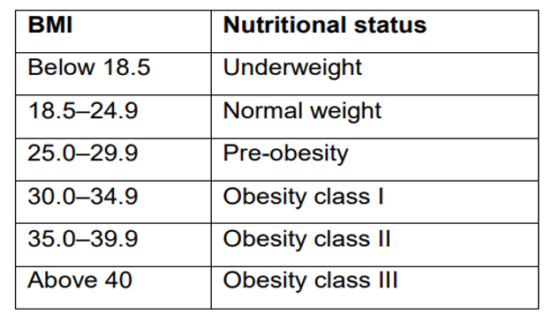

Slide 19
(BMR) Basal Metabolic Rate
Introduction: Basal metabolic rate (BMR) is the amount of energy required to maintain the body's normal metabolic activity, such as respiration, maintenance of body temperature (thermogenesis), and digestion. Specifically, it is the amount of energy required at rest with no additional activity. The energy consumed is sufficient only for the functioning of the vital organs such as the heart, lungs, nervous system, kidneys, liver, intestine, sex organs, muscles, and skin.
Your body converts what you eat and drink into energy. The calories in food and beverages are combined with oxygen to release the energy your body needs to perform your body's most basic (basal) function like breathing and cell production. Even when you are rest, your body needs energy for all of its hidden function such as breathing, circulating blood, adjuring hormone level, growing and repairing cells. The number of calories your body needs to carry out these basic function is known as your basal metabolic rate (BMR)
B.M.R. is the energy released when the subject is at complete mental and physical rest i.e. in a room with comfortable temperature and humidity, awake and sitting in a reclining position, 10-12hrs after the last meal. It is essentially the minimum energy required to maintain the heart-rate, respiration, kidney function etc.

Slide 20
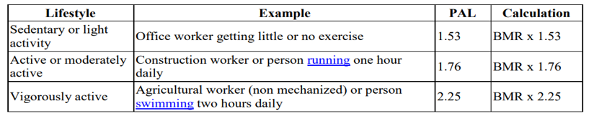
For men: BMR = 10 * weight (kg) + 6.25 * height (cm) - 5 * age ( years ) + 5.
For women: BMR = 10 * weight (kg) + 6.25 * height (cm) - 5 * age ( years ) - 161.
To determine your total daily calorie needs, multiply your BMR by the appropriate activity factor, as follows:
If you are sedentary (little or no exercise): Calorie-Calculation = BMR * 1.2
If you are lightly active (light exercise/sports 1-3 days/week) : Calorie-Calculation = BMR * 1.375
If you are moderately active (moderate exercise/sports 3-5 days/week): Calorie-Calculation = BMR * 1.55
If you are very active (hard exercise/sports 6-7 days a week): Calorie-Calculation = BMR * 1.725.
If you are extra active (very hard exercise/sports & physical job or 2x training) : Calorie-Calculation = BMR * 1.9

Slide 21
WHR(WAIST HIP RATIO) :
WHR is a quick and easy measurement that assesses fat distribution, which can help determine a person's overall risk for developing certain health conditions.
The WHR measurement involves using a tape measure to check the size of your waist and hips. WHR is found by dividing circumference of the waist by the circumference of the hips. Calculating WHR is easy, quick and doesn't cost anything if you already have a tape measure!
How to Calculate Waist-to-Hip Ratio
WHR = WAIST CIRCUMFERENECE / HIP CIRCUMFERENCE
Here's how to measure WHR:
1. Take a waist circumference measurement: Wrap the tape measure around the narrowest part of your stomach, near or just above your belly button. The tape measure should rest gently on your skin, and not be pulled tightly. Once the tape measure is positioned correctly, breathe in gently, and then take the measurement on the exhale. Note the measurement in inches.
2. Take a hip measurement: Stand with your feet directly beneath your hips and wrap the tape around the widest part of your hips and buttocks. Note the measurement in inches.
3. Calculate your WHR: Divide your waist size by your hip size to get your WHR.

